Slide 1
Text mining
IUT AI Student Chapter

Slide 2
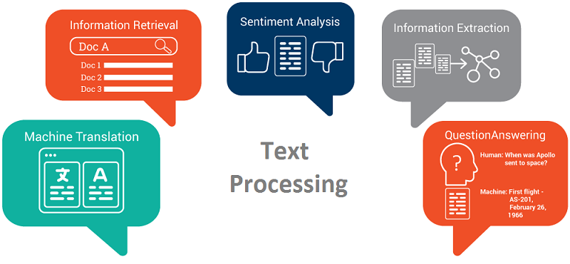
Applications

Slide 3
Pre-processing
Methods that can help us tidy our data
Tokenization
Stop words removal
Stemming
Lemmatization

Slide 4
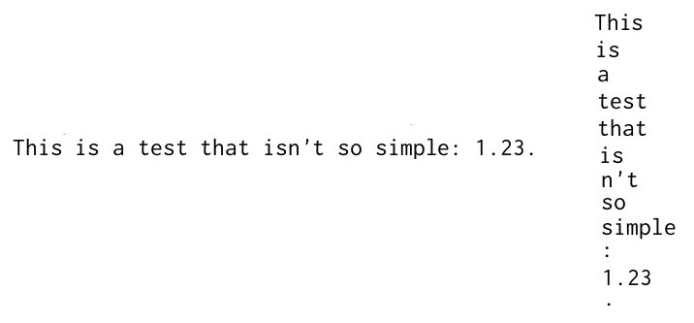
Tokenization

Slide 5
Stop Words
A stop word is a commonly used word which probably won’t give us much information :
“the”, “a”, “an”, “in”, ...

Slide 6
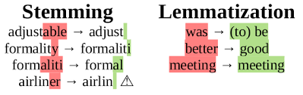
Stemming vs. Lemmatization

Slide 7
Feature extraction
How can we represent text as features to our algorithms?
Bag of Words
Word embeddings
Sentence embeddings

Slide 8
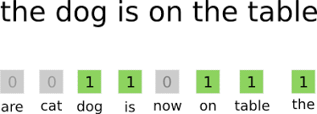
BoW
We consider a vocabulary (e.g. 10 000 words)
Presence of a word in our vocab : 1
Absence of a word in our vocab: 0

Slide 9
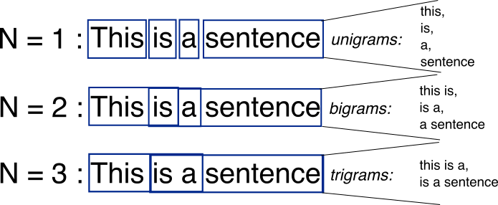
N-Grams
Some words don’t mean by their own:
New york
Sun glasses
Solution:

Slide 10
N-Gram
We can consider n-grams in our vocabulary too.
There’s a lot of them
We can choose most occurring ones

Slide 11
Vocabulary
How can we choose our vocabulary?
All the words occurred in our dataset (Problem?)
Choosing most occurring words (Problem?)
TF-IDF

Slide 12
TF-IDF
Term Frequency(TF) : (Number of times term t appears in a document)/(Number of terms in the document)
Inverse Document Frequency(IDF) :
log((Number of Document)/(Number of documents term t appears on)
TF-IDF = TF * IDF

Slide 13
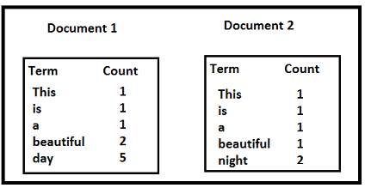
TF-IDF
TF('beautiful',Document1) = 2/10, IDF('beautiful')=log(2/2) = 0
TF(‘day’,Document1) = 5/10, IDF(‘day’)=log(2/1) = 0.30
TF-IDF(‘beautiful’, Document1) = (2/10)*0 = 0
TF-IDF(‘day’, Document1) = (5/10)*0.30 = 0.15

Slide 14
BOW
One of the main disadvantages of this technique is :
Ignoring word orders which is very important sometimes

Slide 15
Word embedding
representation of words where those with the same meaning have a similar representation
Possible arithmetic operations on words!

Slide 16
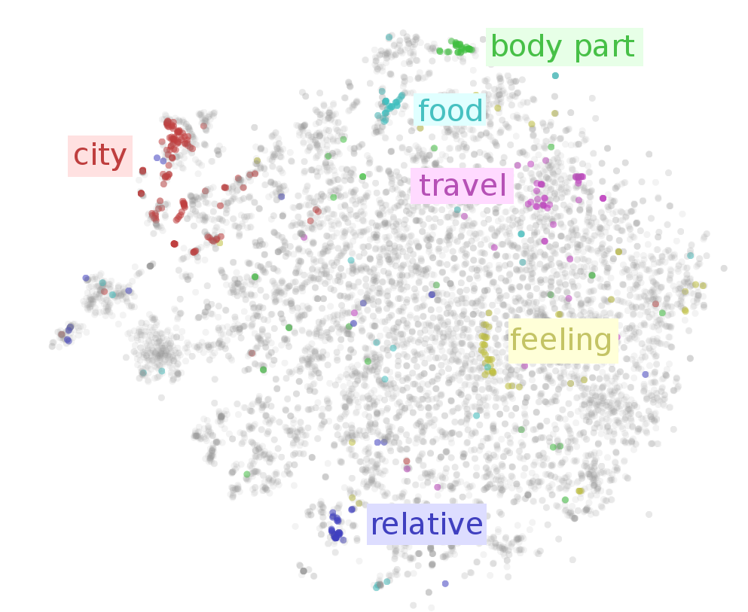
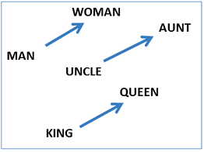
Word embeddings

Slide 17
Word embeddings
Methods for building those vectors:
Neural network based approaches
Skip-gram
CBOW
Co-occurrence matrix
GLoVe

Slide 18
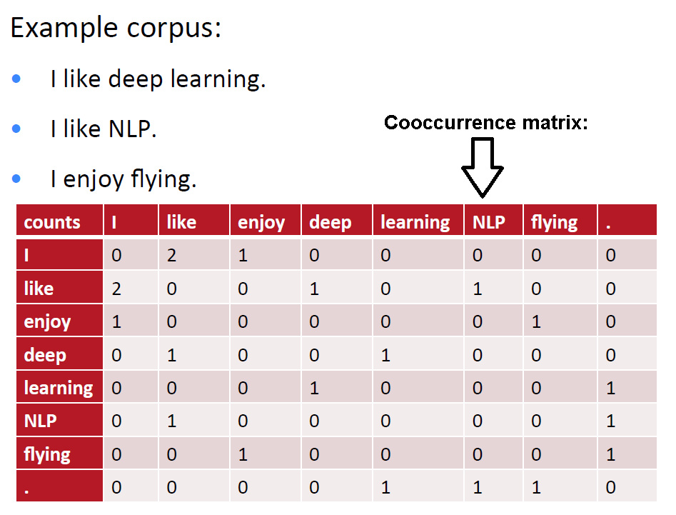
GLoVe

Slide 19
GLoVe
We can add proportional to proximity
Words right before or after : +1
Words with one word in between: +0.5
...
Reducing dimensionality of vectors
SVD
By a Cost function [Pennington et al. (2014)]

Slide 20
Classification Algorithm
We can use all the methods we’ve learned so far:
SVM
Random Forests
…
But There’s another famous one :
Naive Bayes

Slide 21
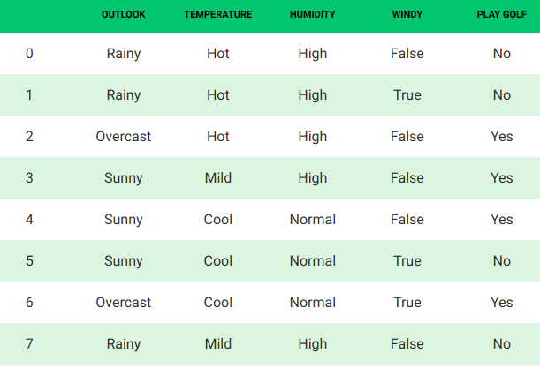
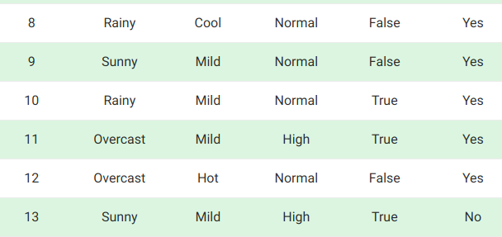
Naive Bayes

Slide 22
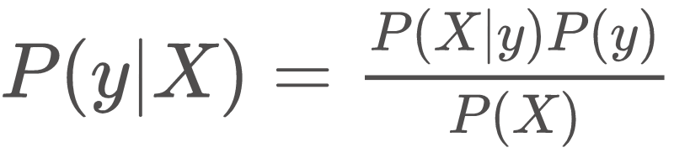
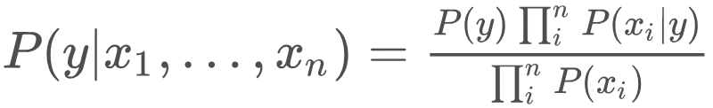
Naive Bayes
Where X denotes our features.
We “Naively” assume independence among features:

Slide 23
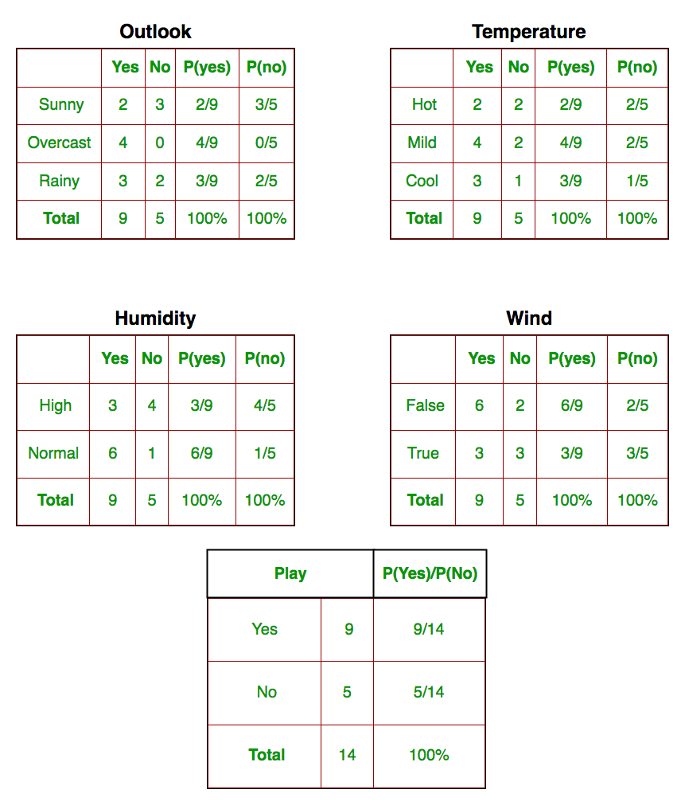

Naive Bayes
Classification Rule:
(Why the denominator is ignored?)

Slide 24
Naive Bayes
today = (Sunny, Hot, Normal, False)
P(Yes|today) ≃ 0.0141
P(No|today) ≃ 0.0068
We normalize them to add up to one:
P(Yes|today) ≃ 0.67 P(No|today) ≃ 0.33

Slide 25
Naive Bayes
What if we have continuous features?
Solution:
We consider they’re sampled from a known distribution.
Now we can use their PDF to compute probabilities.

Slide 26
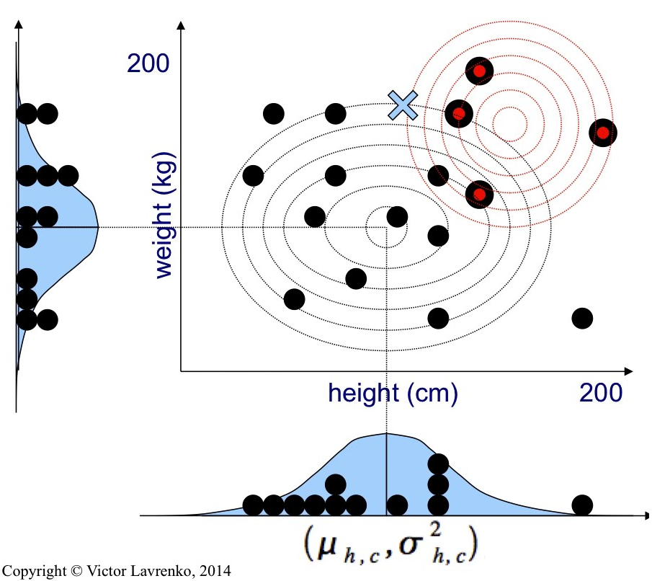
Gaussian Naive Bayes

